Slide 1
AI and Data Science Relationship, Role, History, Branches, Applications.

Slide 2
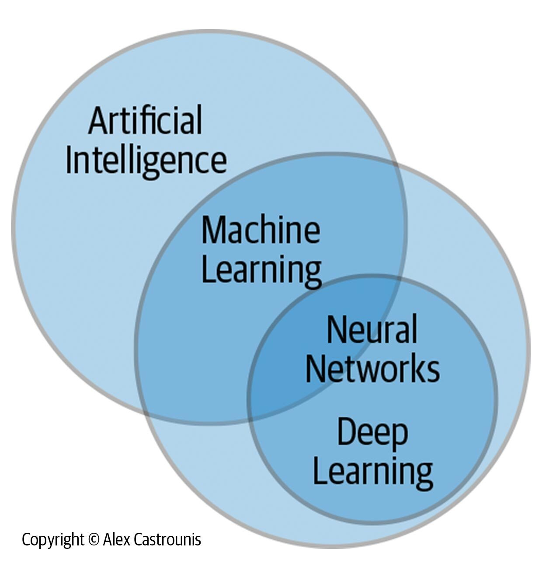
Artificial Intelligence
Artificial Intelligence (AI) is the simulation of human intelligence in machines, enabling them to perform tasks such as learning, reasoning, problem-solving, perception, and language understanding.
"AI" stands for Artificial Intelligence, which refers to the ability of computer systems to perform tasks that typically require human intelligence, such as learning, problem-solving, and decision-making

Slide 3
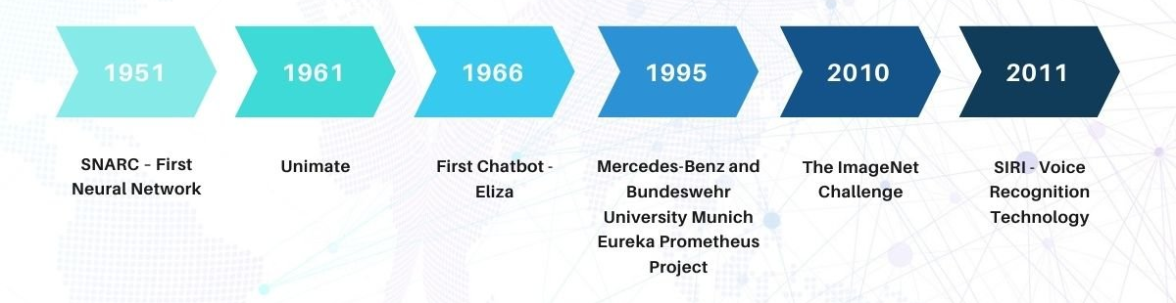
History of AI
Artificial Intelligence (AI) has its roots in the 1950s when the concept of machines mimicking human intelligence was first explored. The term "Artificial Intelligence" was coined by John McCarthy in 1956 during the Dartmouth Conference, which marked the formal beginning of AI as a field of study. Early AI research focused on symbolic reasoning and problem-solving, leading to the development of expert systems in the 1970s and 1980s. The field later advanced with machine learning, neural networks, and deep learning, leading to modern AI applications like natural language processing, computer vision, and large language models.
Father of AI
John McCarthy is known as the "Father of AI" for his pioneering contributions, including the development of the Lisp programming language and his work on AI problem-solving techniques.

Slide 4
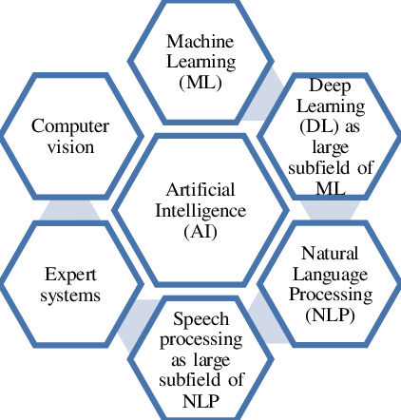
Branches of AI

Slide 5
Branches of AI
Artificial Intelligence (AI) is a vast field with multiple branches, each focusing on different aspects of intelligent systems. Here are the major branches of AI:
Machine Learning (ML) – Enables machines to learn from data and make predictions without explicit programming. Examples: Supervised, Unsupervised, and Reinforcement Learning.
Deep Learning (DL) – A subset of ML that uses artificial neural networks to process large amounts of data and recognize patterns. Used in speech recognition, image processing, and NLP.
Natural Language Processing (NLP) – Deals with understanding and processing human language. Examples: Chatbots, sentiment analysis, machine translation.
Computer Vision – Enables machines to interpret and analyze visual data from images or videos. Examples: Facial recognition, object detection, autonomous vehicles.
Robotics – Focuses on designing and developing robots that can perform tasks autonomously or semi-autonomously. Used in manufacturing, healthcare, and space exploration.
Expert Systems – AI systems that mimic human decision-making by using a knowledge base and inference rules. Used in medical diagnosis, finance, and troubleshooting.
Fuzzy Logic – A reasoning method that handles uncertainty and imprecision, used in control systems and automation.
Reinforcement Learning (RL) – A subset of ML where an agent learns by interacting with an environment through rewards and penalties. Used in gaming, robotics, and self-driving cars.
Speech Recognition – Converts spoken language into text and enables voice assistants like Siri, Alexa, and Google Assistant.
Generative AI – Involves models that generate new content, such as text, images, and music. Examples: ChatGPT, Stable Diffusion, and DALL·E.

Slide 6
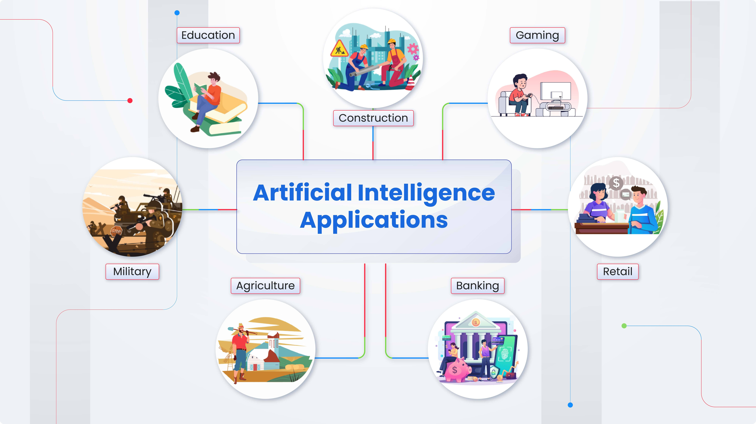
Applications of AI
Healthcare 🏥 – AI is used for disease diagnosis, medical imaging analysis, drug discovery, and personalized treatment plans. Example: AI-powered tools like IBM Watson assist doctors in diagnosing diseases.
Finance 💰 – AI helps in fraud detection, algorithmic trading, risk assessment, and customer service through chatbots. Example: AI-driven fraud detection systems in banking analyze transactions for suspicious activities.
Autonomous Vehicles 🚗 – AI enables self-driving cars to detect objects, interpret traffic signals, and make driving decisions. Example: Tesla’s Autopilot uses AI for navigation and autonomous driving.
E-Commerce & Marketing 🛍️ – AI powers recommendation systems, chatbots, and customer sentiment analysis. Example: Amazon and Netflix use AI to suggest products and movies based on user behavior.
Natural Language Processing (NLP) 🗣️ – AI is used in virtual assistants, machine translation, and sentiment analysis. Example: ChatGPT and Google Translate utilize AI to process and generate human-like language.

Slide 7
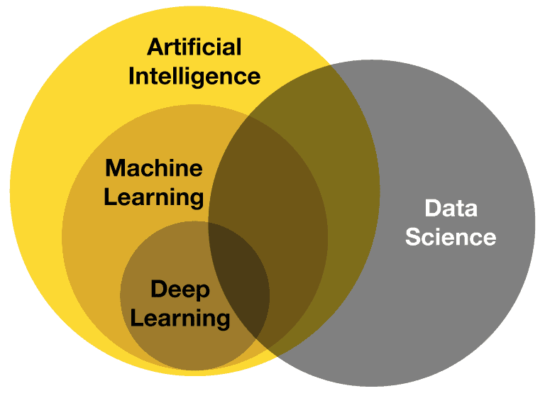
Relation Between AI and Data Science
Data Science is the foundation of AI – AI models rely on data collected, processed, and analyzed by Data Science.
AI uses Data Science for model training – Machine learning and deep learning require well-structured data for accurate predictions.
Big Data fuels AI models – AI thrives on large datasets, and Data Science manages and cleans this data.
AI automates Data Science tasks – AI-driven tools enhance data processing, anomaly detection, and predictive analytics.
AI and Data Science are applied together – Used in healthcare, finance, marketing, and self-driving cars.
AI improves Data Science efficiency – Automates repetitive tasks, allowing Data Scientists to focus on decision-making.
Both fields use Machine Learning techniques – Data Science extracts insights, and AI applies them for intelligent decision-making.

